Slide 1
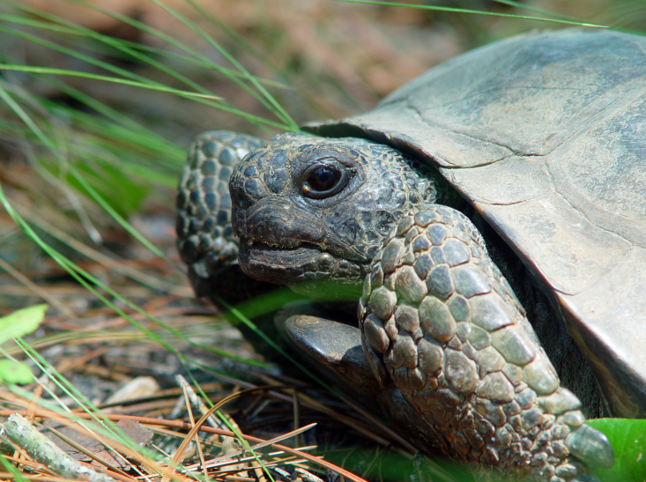
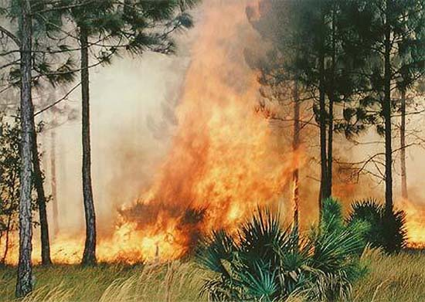
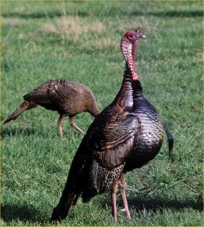
Emma Willcox
Regional Specialized Agent-
Wildlife

Slide 2
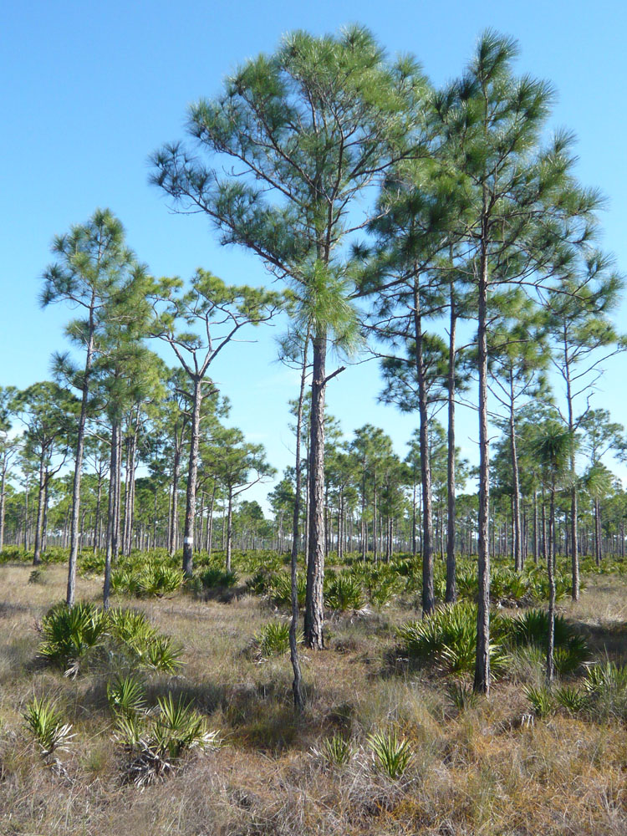
Split Position:
50% Statewide
50% NE District
Levy
Gilchrist
Dixie

Slide 3
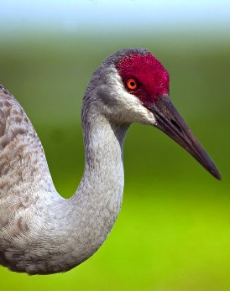
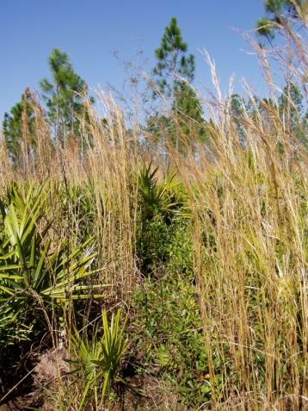
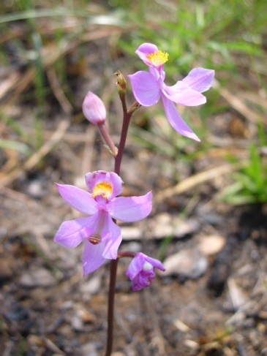
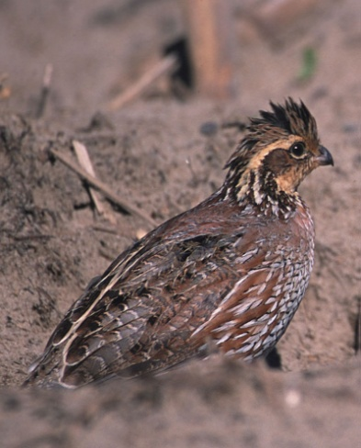
Split Position:
IFAS Extension
Wildlife Ecology & Cons.

Slide 4
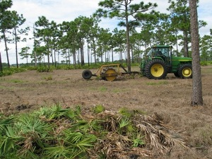
Program Focus:
Management
Wildlife
Habitat
- Private lands
- Uplands

Slide 5
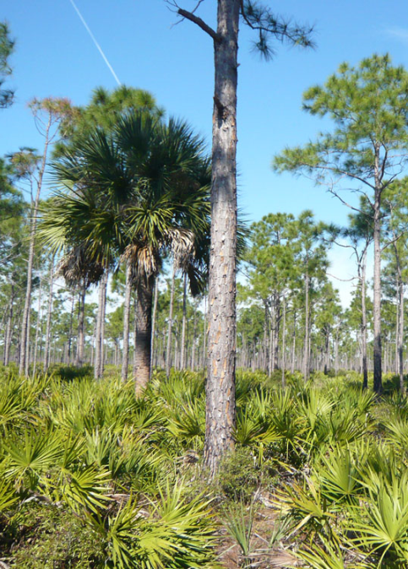
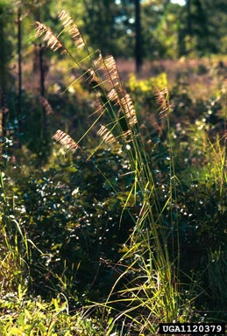
Program Focus:
Help landowners
Restoration
Management
Wildlife recreation

Slide 6
Contact Info:
Levy County Extension
PO Box 219
Bronson, FL 32621
Phone- (352) 486-5131
Email- ewillcox@ufl.edu

